Slide 1


Lecture 23
Produced by Dr. Worldwide
Welcome to the 305
~
~

Slide 2


Descriptive Statistics
A statistic is a quantity computed from a sample AKA a function of the data
Descriptive statistics refers to the analysis of data that helps to describe, visualize, or summarize features in a sample
Purposes for descriptive statistics
Understand the data without seeing the entire dataset
Quantify the center of the data
Quantify the spread of the data
Capture patterns in the data
A frequency table is an array that gives that lists all possible values with counts of how often they occur in the sample (shows the sample distribution
For a numeric variable it is helpful to organize possible values in bins

Slide 3
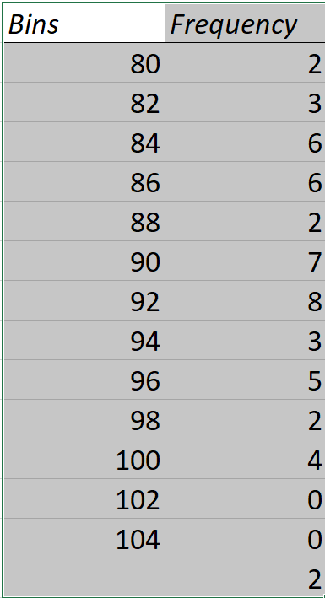
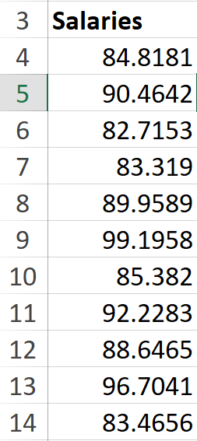
Ex: Starting Salaries
Suppose we have starting salaries of 50 recently graduated students with B.S. degrees in data analytics, recorded the in thousands of dollars per year
Download Salaries.xlsx from link Sheet 1 on course website
Focus on sheet named Frequency
Raw data contained in cells A4:A53
Frequency table contained in cells D4:E17
To create, use the following Excel function
For more help, see Link 1 on course website
=FREQUENCY(data array, bins array)

Slide 4
Ex: Starting Salaries
Bins need to be specified beforehand
The first bin counts the number of values smaller than the bin value and all other bins count the number of values larger than the previous bin but smaller than the current one
To use FREQUENCY, you need to select the array where the results will be displayed and press
CTRL+SHIFT+ENTER (Windows)
CTRL+U or +RETURN (Mac)
Current frequency table breaks up the range of values into bins of size 2
Go to sheet named Practice to create frequency table with bins of size 3

Slide 5
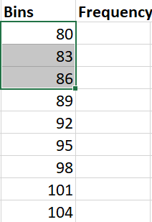
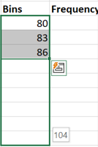
Ex: Starting Salaries
Bins need to be created
Select the three cells C4:C6
Hover cursor over the bottom right corner until you see “+”
Click and drag cursor down to C12
Excel detects and continues patterns

Slide 6
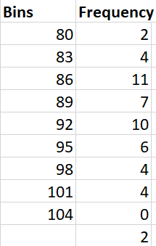
Ex: Starting Salaries
Frequencies need to be added to the table
Select D4 (or D4:D13) and input the formula
You may need to use shortcuts to create vector of frequencies
Q: Why is the frequency table better than the original data?
=FREQUENCY(A4:A53, C4:C12)

Slide 7
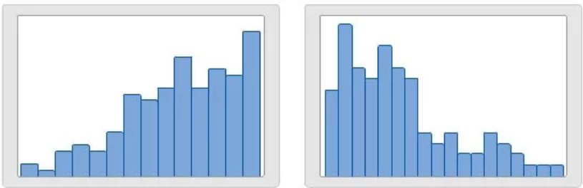
Descriptive Statistics
A histogram is a graph based off a frequency table for a numeric variable
The histogram is the most common graph used to understand the variability in numeric data
The histogram is built off rectangles whose heights represent the number of observations within each bin
Histogram gives us an estimate of the distribution in the population
Three things we learn from a histogram
Shape of the distribution (left skewed or right skewed)
Range of values
Outlier identification

Slide 8
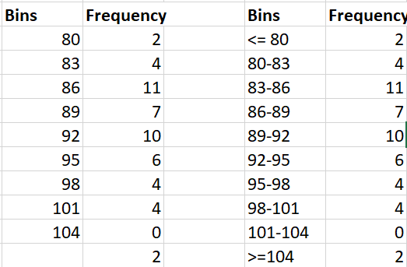
Ex: Starting Salaries
Various ways to build a histogram in Excel
Created from frequency table
Copy and paste frequency values (not formulas)
Highlight the two columns of bin names and frequencies

Slide 9
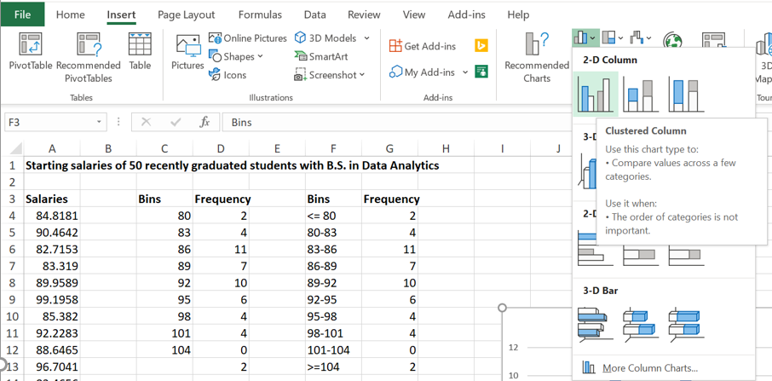
Ex: Starting Salaries
Created from frequency table
Select appropriate chart (clustered column) through Insert menu

Slide 10
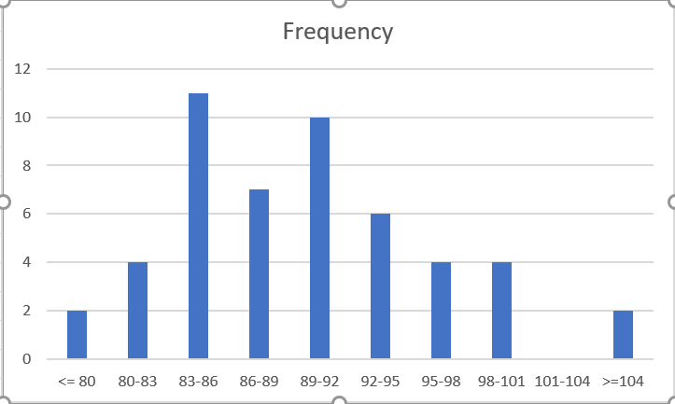
Ex: Starting Salaries
Created from frequency table
Observe the default plot which needs to be fixed
Double click on plot to get sidebar menu for easy editing of elements
Select the x-axis labels for modification and try to figure out how to rotate the text to -21 degrees

Slide 11
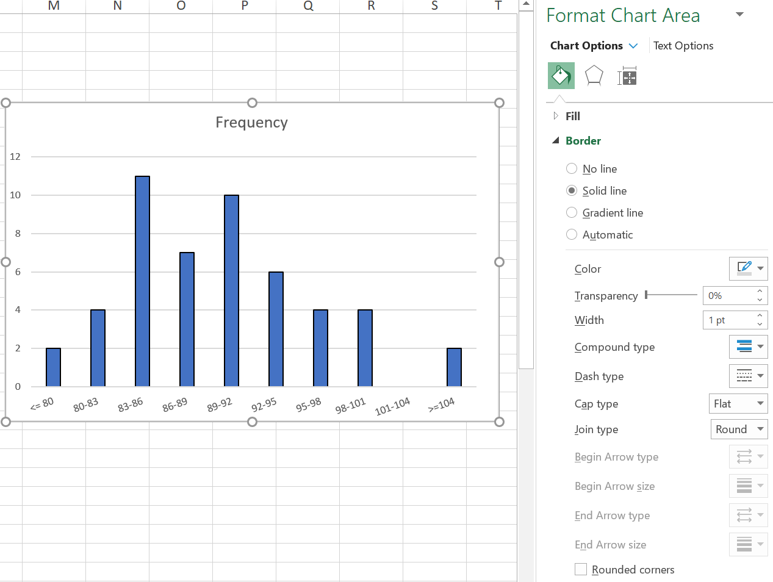
Ex: Starting Salaries
Created from frequency table
Select text options, then textbox, then make custom angle -21 degrees
Select the rectangles and give boxes a 1pt black border

Slide 12
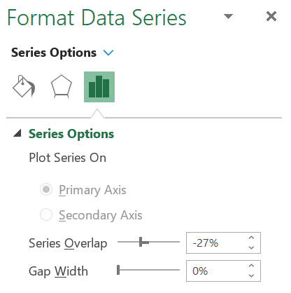
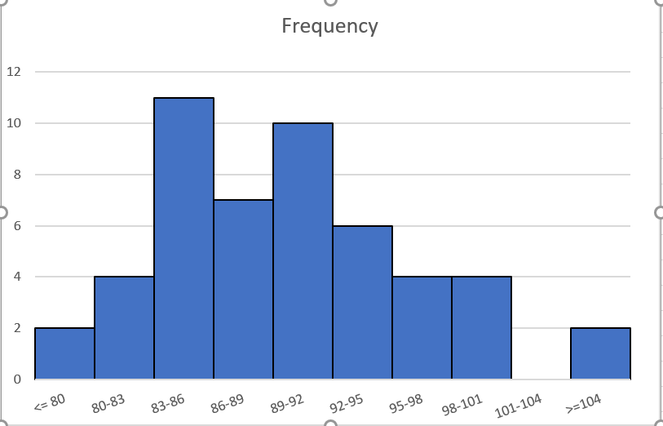
Ex: Starting Salaries
Created from frequency table
When rectangles are selected, select Series Options, and make Gap Width=0
Select the title Frequency and change to Starting Salaries

Slide 13
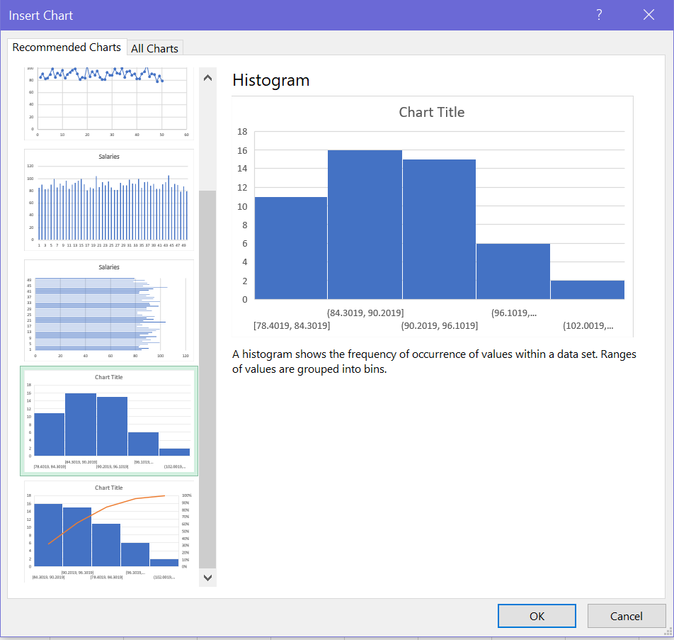
Ex: Starting Salaries
Created from raw data
Highlight raw data and variable name in A3:A53
Select Recommended Charts in Insert menu
Select Histogram and select OK

Slide 14
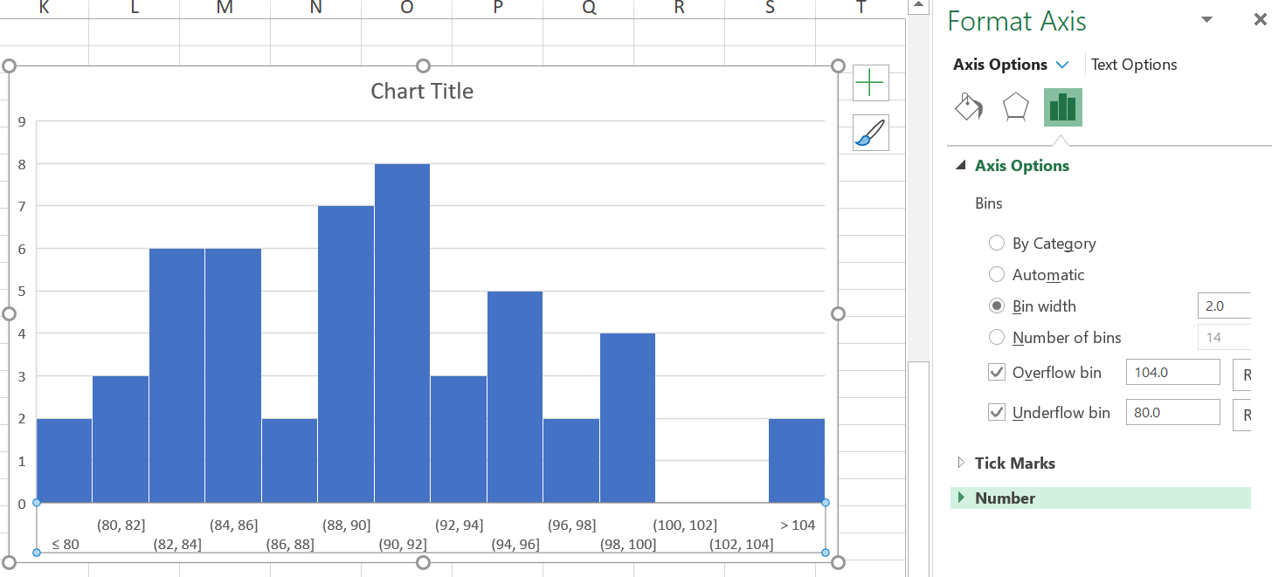
Ex: Starting Salaries
Created from raw data
Select x-axis and modify Axis Options
We can build a histogram similar to previous histogram

Slide 15
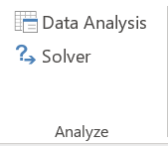
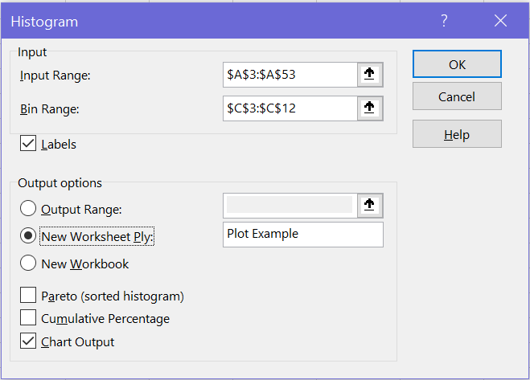
Ex: Starting Salaries
Created using the Analysis ToolPak add-in
Look at Link 2 for help with loading the Analysis ToolPak
This may be automatically loaded on your computer
Above Excel Solver you will find Data Analysis
Select Histogram and fill out fields

Slide 16
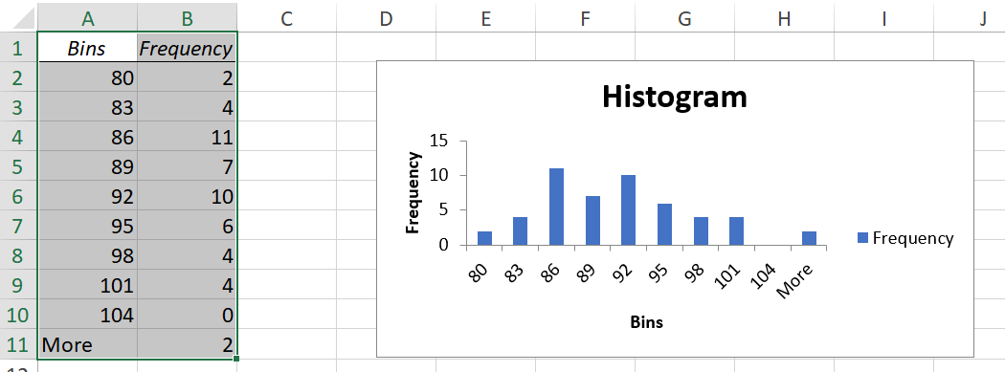
Ex: Starting Salaries
Created using the Analysis ToolPak add-in
Result found in new sheet named Plot Example
Requires more modification

Slide 17

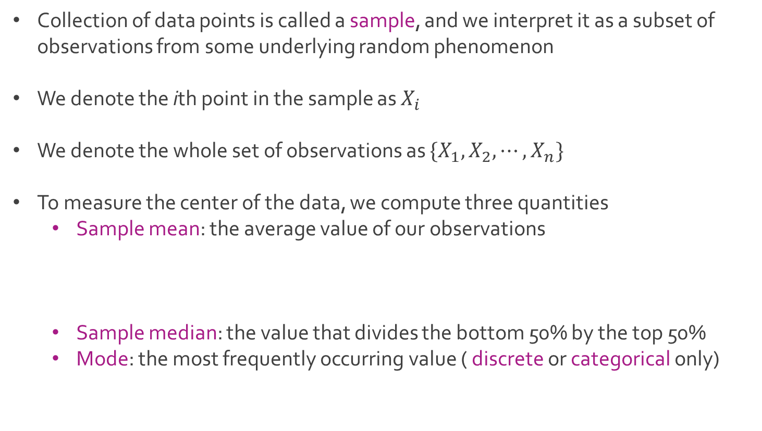
Descriptive Statistics
Collection of data points is called a sample, and we interpret it as a subset of observations from some underlying random phenomenon
We denote the ith point in the sample as $X_{i}$
We denote the whole set of observations as ${\{X}_{1},X_{2}, ⋯, X_{n}\}$
To measure the center of the data, we compute three quantities
Sample mean: the average value of our observations
Sample median: the value that divides the bottom 50% by the top 50%
Mode: the most frequently occurring value ( discrete or categorical only)

Slide 18
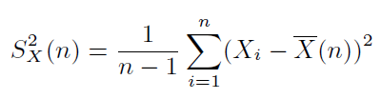
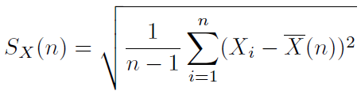
Descriptive Statistics
Q: Why calculate the sample mean and sample median?
To measure the spread of the data, we compute three quantities
Sample variance: the average squared distance between an observation and the sample mean
Sample standard deviation: more convenient than the sample variance
Range: the difference between the largest value and smallest value

Slide 19
Descriptive Statistics
Percentiles are also helpful
The kth percentile is a value that divides the bottom k% from the top (1-k)%
The median is the 50th percentile
The 25th and 75th percentiles (Q1 and Q3) are useful for understanding the variability in the middle of the distribution
The interquartile range (IQR) is the difference between Q3 and Q1

Slide 20
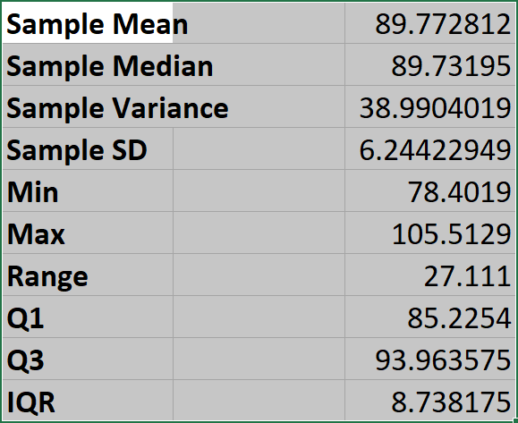
Ex: Starting Salaries
Analyze the formulas for these statistics in the Frequency sheet

Slide 21
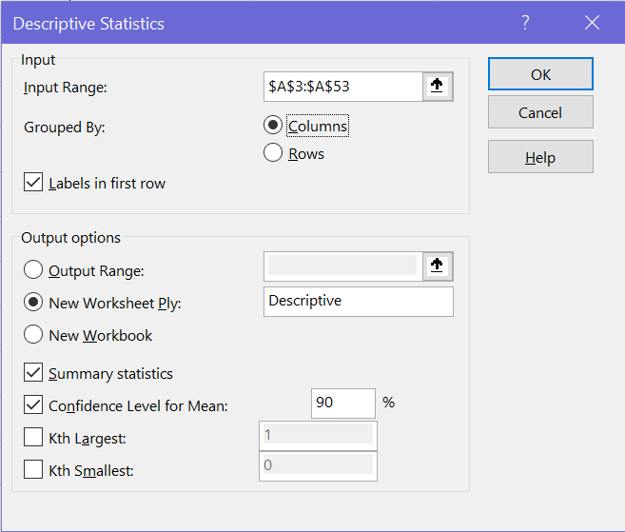
Ex: Starting Salaries
More information can be gathered using Data Analysis in the Data menu

Slide 22




The End
Dale

